Slide 1
Digital Portfilo
STUDENT NAME: Dakshesh.s
REGISTER NO AND NMID: 212400932 / EE3595CD2E9F139965A4C85D54B9D3BE
DEPARTMENT: BCA
COLLEGE: PRINCE SHRI VENKATESWARA ARTS AND SCIENCE COLLEGE

Slide 2
Problem statement
In today’s digital world, having an online presence is essential for students and professionals to showcase their skills and projects. Many individuals face challenges in presenting their abilities, experiences, and achievements in a modern, interactive, and professional manner. A simple resume is often not enough to highlight practical skills and technical expertise. Therefore, a personal portfolio website is required to effectively demonstrate one’s capabilities, academic background, and projects to potential employers, recruiters, and collaborators.

Slide 3
AGENDA
Problem Statement
Project Overview
End Users
Tools and Technologies
Portfolio design and Layout
Features and Functionality
Results and Screenshots
Conclusion
Github Link

Slide 4

Problem Statement
The project addresses a significant challenge within the market, aiming to enhance user experience and functionality through innovative solutions.

Slide 5
End Users
The primary audience for this project includes stakeholders, clients, and end-users, all benefiting from improved services and interactions. Understanding their needs is crucial for project success.

Slide 6
Tools and Technologies
The project utilizes advanced tools and technologies to ensure efficiency and effectiveness. Key components include software, frameworks, and hardware that support smooth operations and enhance user experience.

Slide 7
Design and Features
Theme: Dark background with gradient highlights (modern & professional look).
Typography: Clean fonts (Arial, sans-serif) for readability.
Layout: Section-based structure → About Me, Skills, Projects, and Contact.
About Me Section – A short bio introducing the student.
Skills Section – Showcases programming and web development skills.
Projects Section – Displays work samples with descriptions.

Slide 8
Portfolio Design and Layout
The design prioritizes usability and aesthetics, featuring an intuitive layout that allows users to navigate easily. Employing best practices in design ensures that the portfolio stands out while remaining functional.

Slide 9

Features and Functionality
Key features include responsive design, user-friendly interfaces, and robust functionality. Each element is crafted to enhance user engagement and satisfaction, demonstrating our commitment to excellence in product development.

Slide 10
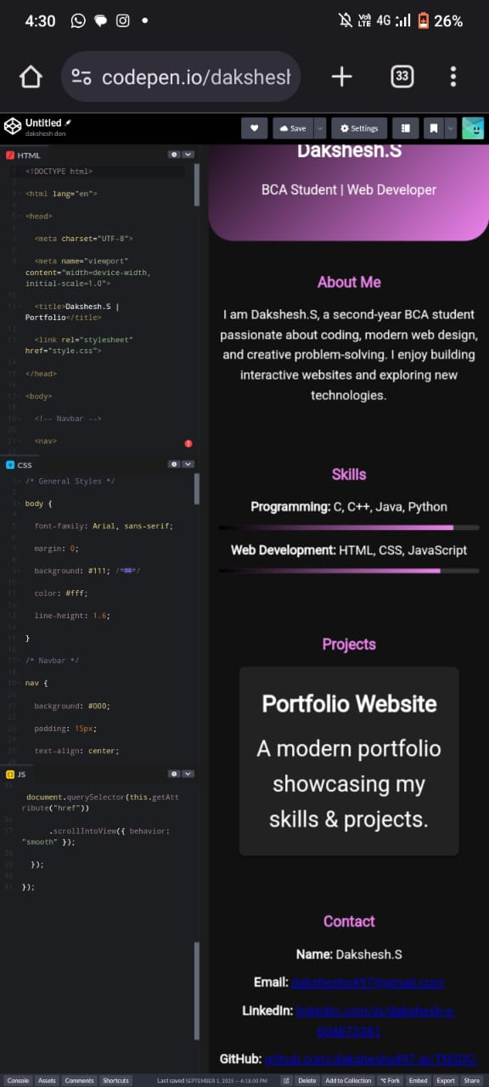
Results and Screenshots

Slide 11

Conclusions
The project successfully addresses the identified problems, delivering a solution that meets user needs and leverages current technologies. Future enhancements will further solidify its position in the market.

Slide 12
https://daksheshs497-ai.github.io/TNSDC-FWD-DP-dakshesh-portfolio/
GITHUB LINK

